Slide 1

Maths 10
Time to integrate

Slide 2
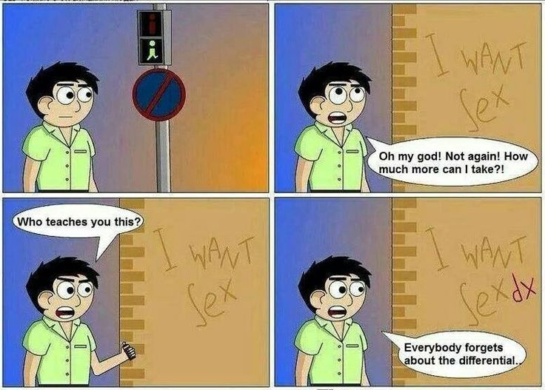
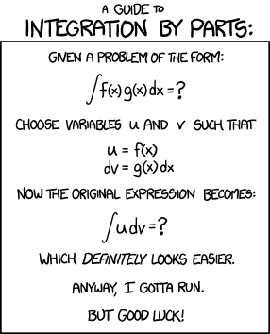
Integration and antiderivatives

Slide 3
Integration and antiderivatives
We have covered differentiation, half of calculus, which is about understanding the rate of change of a function.
The second half of calculus is integration which focuses on calculating the area under a curve.

Slide 4
Integration and antiderivatives
The beginning of integration is the antiderivative.
This is the reverse function of derivation.

Slide 5
Integration and antiderivatives
The beginning of integration is the antiderivative.
This is the reverse function of derivation.
If we look at a standard function:
y= 2x²+ 3x - 4

Slide 6
Integration and antiderivatives
The beginning of integration is the antiderivative.
This is the reverse function of derivation.
If we look at a standard function:
y= 2x²+ 3x – 4
y’ = 4x + 3

Slide 7
Integration and antiderivatives
If we look at a standard function:
y= 2x²+ 3x – 4
y’ = 4x + 3
So what happens if we are just given the y’ = 4x +3?

Slide 8
Integration and antiderivatives
So what happens if we are just given the y’ = 4x +3?
We know that it is x¹ so the previous exponent was 2.
So we divide the 4/2 and increase the power.
y = 2x² + 3

Slide 9
Integration and antiderivatives
So what happens if we are just given the y’ = 4x +3?
We know that it is x¹ so the previous exponent was 2.
So we divide the 4/2 and increase the power.
y = 2x² + 3
And we know it is x⁰ so it is x¹ now.

Slide 10
Integration and antiderivatives
So what happens if we are just given the y’ = 4x +3?
We know that it is x¹ so the previous exponent was 2.
So we divide the 4/2 and increase the power.
y = 2x² + 3x
And we know it is x⁰ so it is x¹ now.

Slide 11
Integration and antiderivatives
y = 2x² + 3x
Hmmm that’s almost right but we’ve lost our constant!
But how can we know what the constant was?

Slide 12
Integration and antiderivatives
y = 2x² + 3x
Hmmm that’s almost right but we’ve lost our constant!
But how can we know what the constant was?
We can’t. Instead we just write + c a constant that can be anything.

Slide 13
Integration and antiderivatives
y = 2x² + 3x + c
This antiderivative is a function that can looks the same but can cross the y axis at any of an infinite number of points.

Slide 14
Integration and antiderivatives
What we did is the first step of integration.
We have reversed a derivative to get an original function.
But if we integrate a regular function we can work out the area under the curve.
There are lots of uses of this.

Slide 15
Integration and antiderivatives
So we have a function and want to find out how much area there is under it.
How would we do this manually?

Slide 16
Integration and antiderivatives
So we have a function and want to find out how much area there is under it.
How would we do this manually?
Well we could try taking slices of area
and combining them.
Doesn’t look very good.

Slide 17
Integration and antiderivatives
So we have a function and want to find out how much area there is under it.
How would we do this manually?
Well we could try taking slices of area
and combining them.
Smaller slices?

Slide 18
Integration and antiderivatives
So we have a function and want to find out how much area there is under it.
How would we do this manually?
Well we could try taking slices of area
and combining them.
The smaller the slices the better

Slide 19
Integration and antiderivatives
So we have a function and want to find out how much area there is under it.
How would we do this manually?
Once the slices are infinitely small we
have a good approximation of the area.

Slide 20
Integration and antiderivatives
So we have a function and want to find out how much area there is under it.
Once the slices are infinitely small we
have a good approximation of the area.
This is the process of integration

Slide 21
Integration and antiderivatives
So we have a function and want to find out how much area there is under it.
Once the slices are infinitely small we
have a good approximation of the area.
This is the process of integration
Breaking function into changes of x

Slide 22
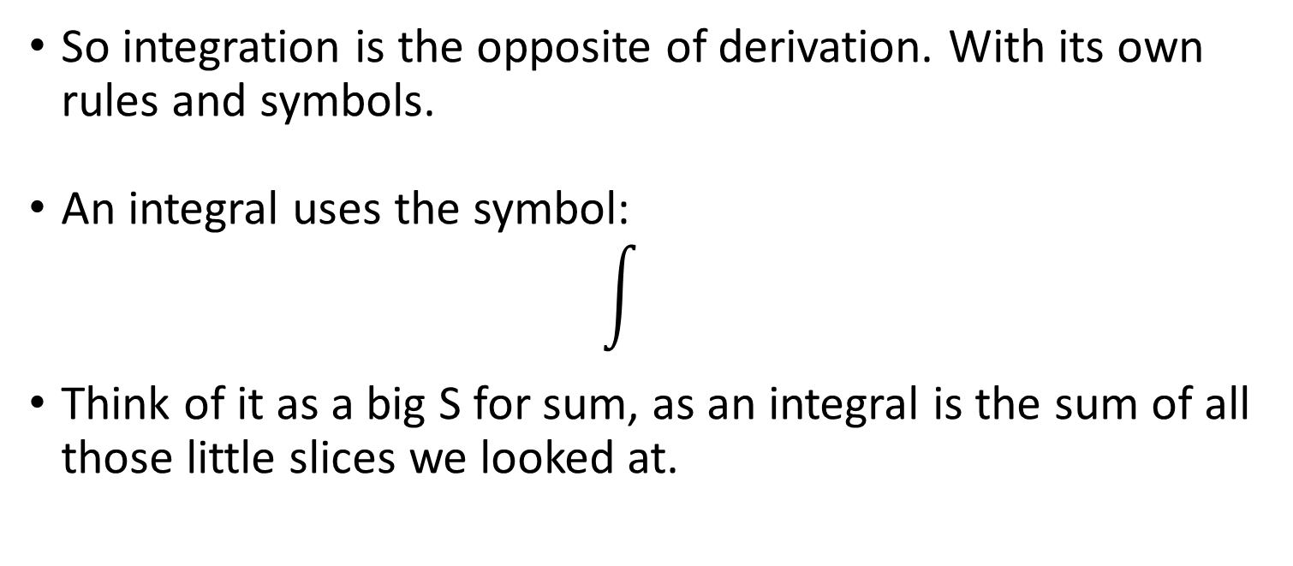
Integration and antiderivatives
So integration is the opposite of derivation. With its own rules and symbols.
An integral uses the symbol:
Think of it as a big S for sum, as an integral is the sum of all those little slices we looked at.

Slide 23
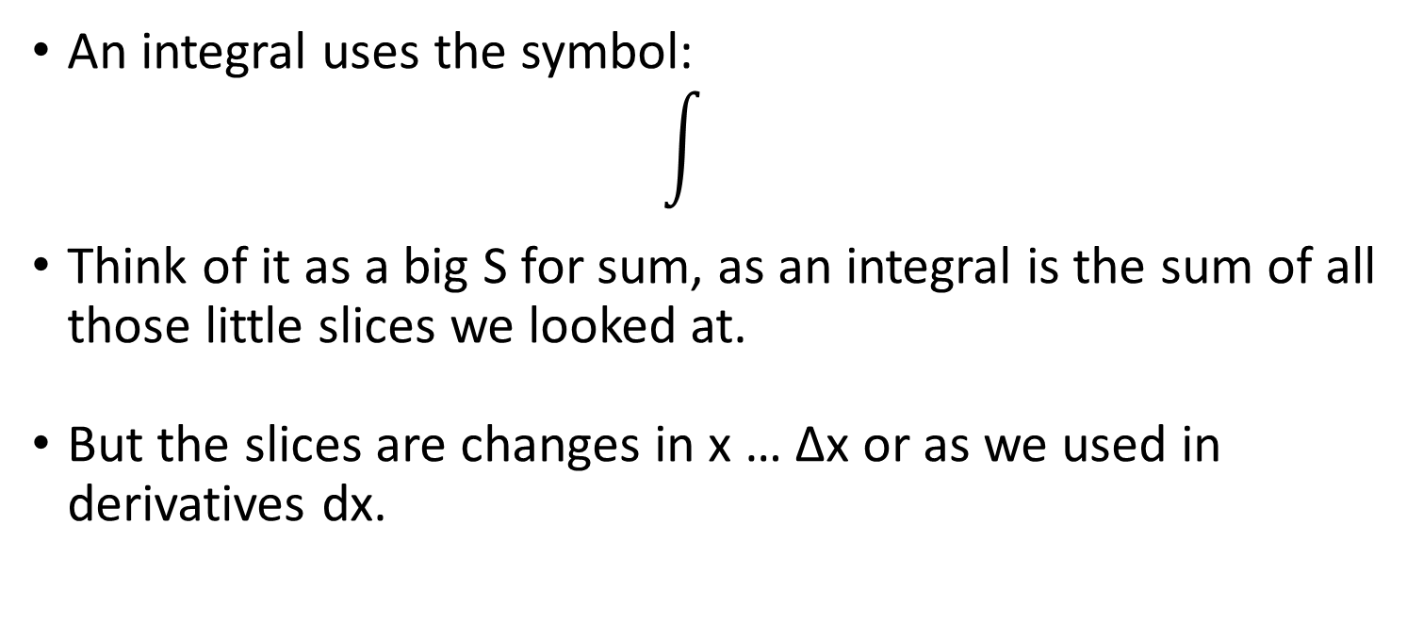
Integration and antiderivatives
An integral uses the symbol:
Think of it as a big S for sum, as an integral is the sum of all those little slices we looked at.
But the slices are changes in x … ∆x or as we used in derivatives dx.

Slide 24
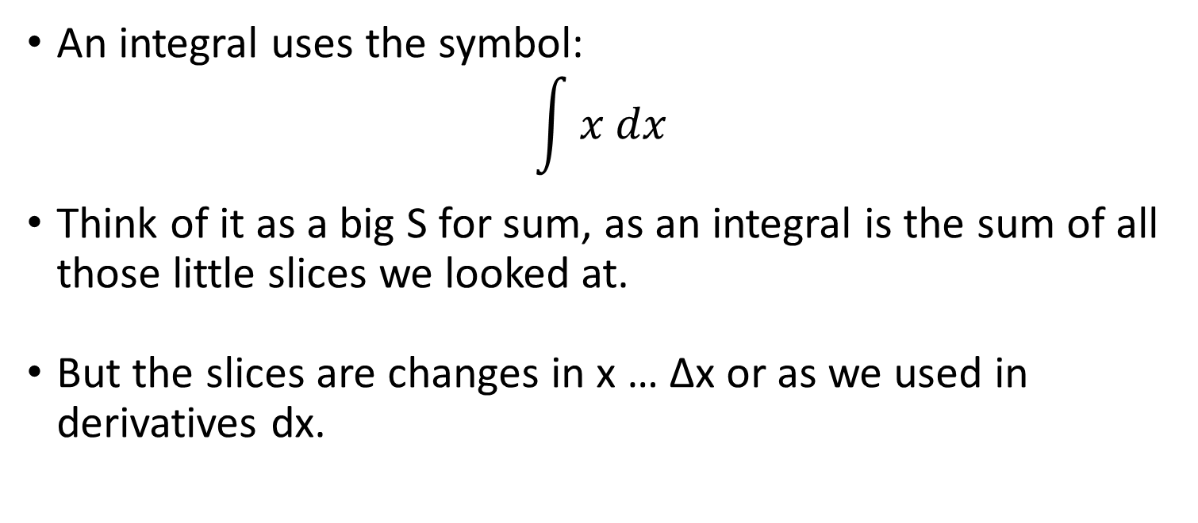
Integration and antiderivatives
An integral uses the symbol:
$$\int{x dx}$$
Think of it as a big S for sum, as an integral is the sum of all those little slices we looked at.
But the slices are changes in x … ∆x or as we used in derivatives dx.

Slide 25

Integration and antiderivatives
If we return to our anti derivative function we can phrase it:
$$\int{{2x}^{2}+3x+c dx}$$

Slide 26
Integration and antiderivatives
So what are our basic rules of integration?
Well mostly just opposites of our differentiation rules.
We’ve already used a couple

Slide 27

Integration and antiderivatives
If we have a constant:
$\int{4 dx}$
It becomes:
$$\int{4x+c dx}$$

Slide 28

Integration and antiderivatives
If we have a variable of any exponent:
$$\int{x^{n} dx}$$
It becomes:
$$\int{\frac{x^{n+1}}{n}+c dx}$$

Slide 29

Integration and antiderivatives
If we have a function multiplied by a constant:
$$\int{C(f\left(x\right)) dx}$$
It is the same as:
C$\int{f\left(x\right) dx}$

Slide 30

Integration and antiderivatives
If we have a reciprocal function:
$$\int{\frac{1}{x} dx}$$
It becomes:
ln|x| + C

Slide 31
Integration and antiderivatives
If we have a reciprocal function:
$$\int{\frac{1}{x} dx}$$
It becomes:
ln|x| + C

Slide 32

Integration and antiderivatives
If we have an exponential function:
$$\int{a^{x} dx}$$
It becomes:
$$\frac{a^{x}}{ln⁡(a)}+C$$

Slide 33

Integration and antiderivatives
If we have a log function:
$$\int{\log_{b}{x} dx}$$
It becomes:
$$x\log_{b}{x} −x+C$$

Slide 34
Integration and antiderivatives
There are more complicated ways of integrating (although they actually make more complicated functions easier) when functions follow a certain format.
The first is integration by substitution.

Slide 35
Integration and antiderivatives
Integration by substitution.
This only works in special cases where you have nested functions and can substitute in a new variable instead of one of the functions.

Slide 36

Integration and antiderivatives
Integration by substitution.
Say we have want an integral of a function that looks like:
$$\int{f(g\left(x\right)) dx}$$

Slide 37
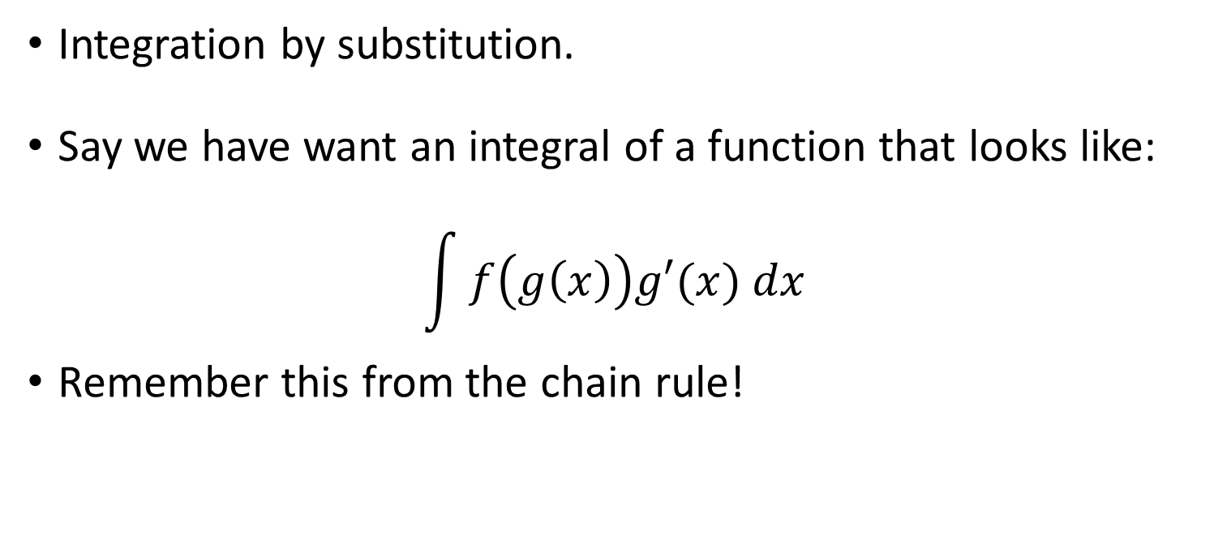
Integration and antiderivatives
Integration by substitution.
Say we have want an integral of a function that looks like:
$$\int{f\left(g\left(x\right)\right)g′(x) dx}$$
Remember this from the chain rule!

Slide 38

Integration and antiderivatives
If we look at a function:
$$\int{{\left(4x −6\right)}^{2} dx}$$

Slide 39

Integration and antiderivatives
If we look at a function:
$$\int{{\left(4x −6\right)}^{2} dx}$$
We have 2 functions g = 4x – 6 and f = x²

Slide 40
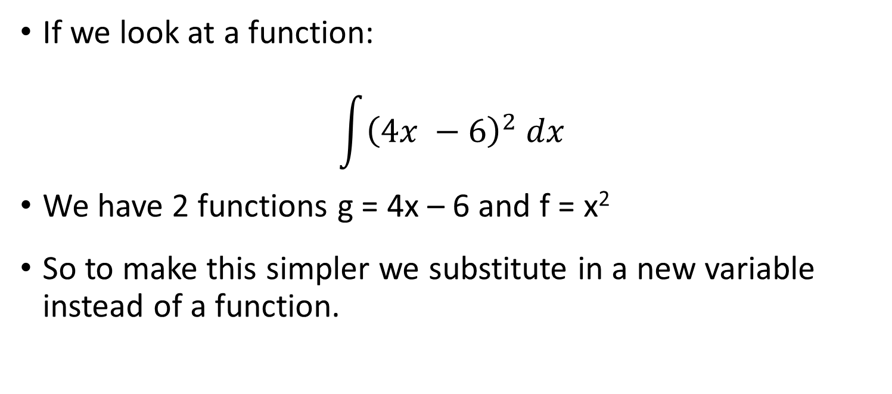
Integration and antiderivatives
If we look at a function:
$$\int{{\left(4x −6\right)}^{2} dx}$$
We have 2 functions g = 4x – 6 and f = x²
So to make this simpler we substitute in a new variable instead of a function.

Slide 41

Integration and antiderivatives
If we look at a function:
$$\int{{\left(4x −6\right)}^{2} dx}$$
Replace (4x – 6) with y

Slide 42

Integration and antiderivatives
If we look at a function:
$$\int{y^{2} dx}$$
Replace (4x – 6) with y

Slide 43
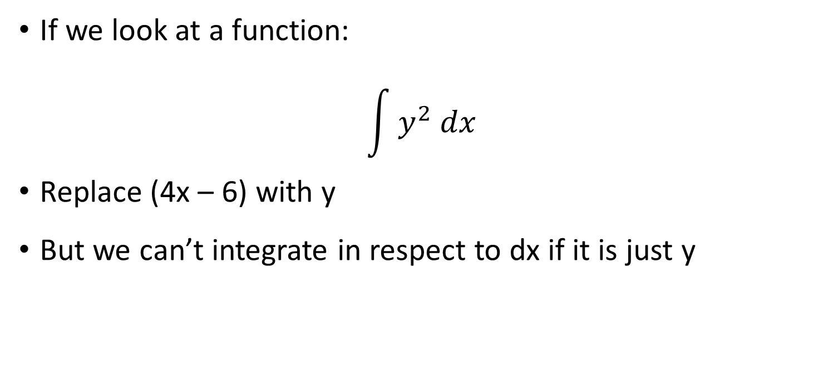
Integration and antiderivatives
If we look at a function:
$$\int{y^{2} dx}$$
Replace (4x – 6) with y
But we can’t integrate in respect to dx if it is just y

Slide 44
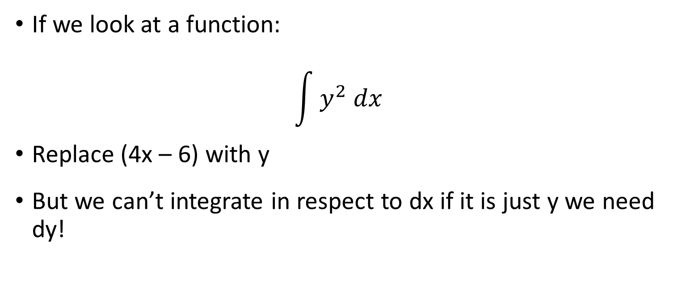
Integration and antiderivatives
If we look at a function:
$$\int{y^{2} dx}$$
Replace (4x – 6) with y
But we can’t integrate in respect to dx if it is just y we need dy!

Slide 45

Integration and antiderivatives
If we look at a function:
$$\int{y^{2} dx}$$
dy/dx = 4
But we can’t integrate in respect to dx if it is just y we need dy!

Slide 46

Integration and antiderivatives
If we look at a function:
$$\int{y^{2} dx}$$
dx = ¼ dy
But we can’t integrate in respect to dx if it is just y we need dy!

Slide 47

Integration and antiderivatives
If we look at a function:
$$\int{y^{2} dx}$$
dx = ¼ dy
Ok now we sub our new dx term.

Slide 48

Integration and antiderivatives
If we look at a function:
$$\int{y^{2}\frac{1}{4} dy}$$
dx = ¼ dy
Ok now we sub our new dx term.

Slide 49

Integration and antiderivatives
If we look at a function:
$$\int{y^{2}\frac{1}{4} dy}$$
That is a constant so we can take it outside.

Slide 50

Integration and antiderivatives
If we look at a function:
$$\frac{1}{4}\int{y^{2} dy}$$
That is a constant so we can take it outside.

Slide 51

Integration and antiderivatives
If we look at a function:
$$\frac{1}{4}\int{y^{2} dy}$$
Integrate this now

Slide 52

Integration and antiderivatives
If we look at a function:
$$\frac{1}{4} ×\frac{1}{3}y^{3}+C$$
Integrate this now

Slide 53

Integration and antiderivatives
If we look at a function:
$$\frac{1}{4} ×\frac{1}{3}y^{3}+C$$
Now we can sub our original value of y back in

Slide 54

Integration and antiderivatives
If we look at a function:
$$\frac{1}{4} ×\frac{1}{3}{(4x−6)}^{3}+C$$
Now we can sub our original value of y back in

Slide 55

Integration and antiderivatives
If we look at a function:
$$\frac{1}{12}{(4x−6)}^{3}+ C$$
Simplify

Slide 56

Integration and antiderivatives
If we look at a function:
$$\frac{1}{12}{(4x−6)}^{3}+ C$$
Finished! This is our integral.

Slide 57

Integration and antiderivatives
Lets try a bit more complicated one:
$$\int{\frac{x}{x^{2}+1} dx}$$

Slide 58

Integration and antiderivatives
Lets try a bit more complicated one:
$$\int{\frac{x}{x^{2}+1} dx}$$
The derivative of x² + 1 is 2x

Slide 59
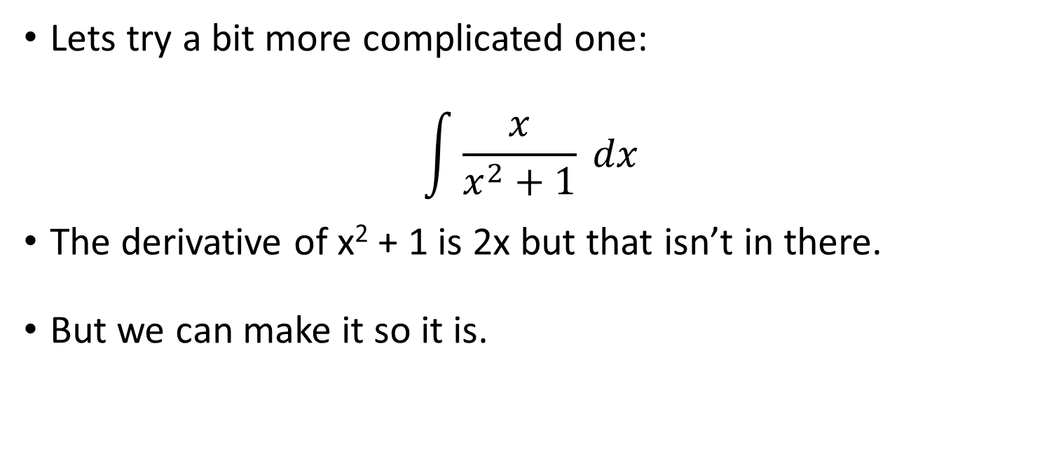
Integration and antiderivatives
Lets try a bit more complicated one:
$$\int{\frac{x}{x^{2}+1} dx}$$
The derivative of x² + 1 is 2x but that isn’t in there.
But we can make it so it is.

Slide 60
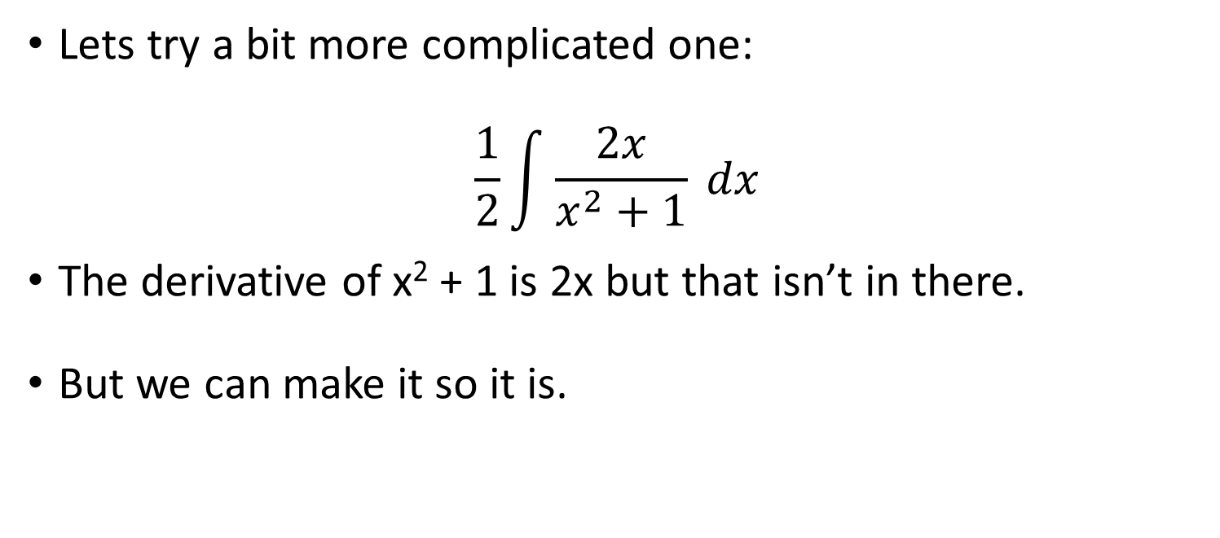
Integration and antiderivatives
Lets try a bit more complicated one:
$$\frac{1}{2}\int{\frac{2x}{x^{2}+1} dx}$$
The derivative of x² + 1 is 2x but that isn’t in there.
But we can make it so it is.

Slide 61
Integration and antiderivatives
Lets try a bit more complicated one:
$$\frac{1}{2}\int{\frac{2x}{x^{2}+1} dx}$$
The derivative of x² + 1 is 2x but that isn’t in there.
But we can make it so it is.

Slide 62
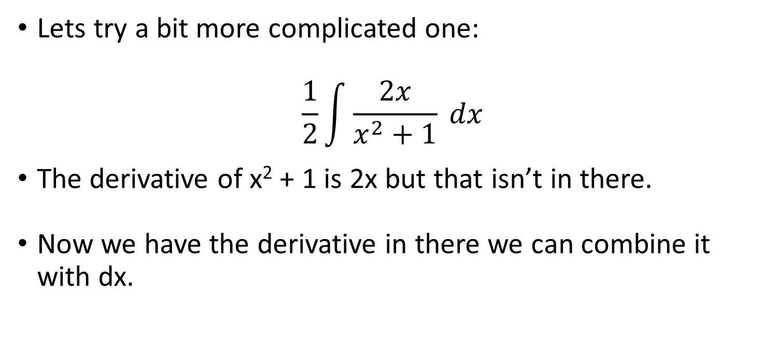
Integration and antiderivatives
Lets try a bit more complicated one:
$$\frac{1}{2}\int{\frac{2x}{x^{2}+1} dx}$$
The derivative of x² + 1 is 2x but that isn’t in there.
Now we have the derivative in there we can combine it with dx.

Slide 63
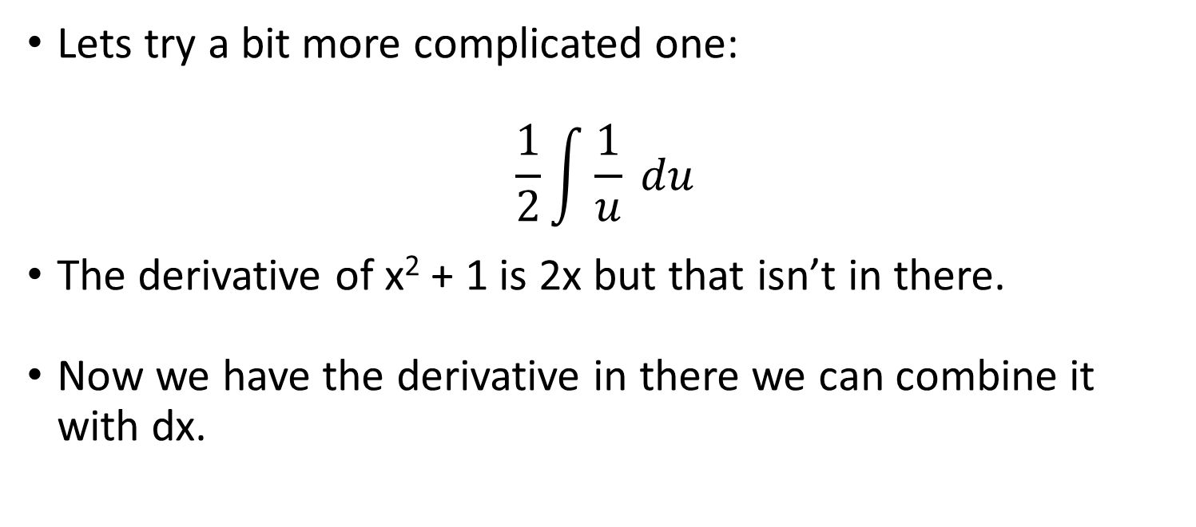
Integration and antiderivatives
Lets try a bit more complicated one:
$$\frac{1}{2}\int{\frac{1}{u} du}$$
The derivative of x² + 1 is 2x but that isn’t in there.
Now we have the derivative in there we can combine it with dx.

Slide 64

Integration and antiderivatives
Lets try a bit more complicated one:
$$\frac{1}{2}\int{\frac{1}{u} du}$$
And we know what a reciprocal becomes.

Slide 65

Integration and antiderivatives
Lets try a bit more complicated one:
$$\frac{1}{2}\ln\left(u\right)+C$$
And we know what a reciprocal becomes.

Slide 66

Integration and antiderivatives
Lets try a bit more complicated one:
$$\frac{1}{2}\ln\left(x^{2}+1\right)+C$$
Substitute the original function in.

Slide 67
Integration and antiderivatives
When we see an integral is made up of multiple functions that can be broken up it is often possible to substitute in a variable for one function and work from there.
This makes it easier to work with.

Slide 68
Integration and antiderivatives
When we see an integral is made up of multiple functions that can be broken up it is often possible to substitute in a variable for one function and work from there.
This makes it easier to work with.

Slide 69
Integration and antiderivatives
There is a second method of integrating complex functions:
Integration by parts.

Slide 70
Integration and antiderivatives
There is a second method of integrating complex functions:
Integration by parts.
This is done when an integral is the product of two functions.

Slide 71

Integration and antiderivatives
$$\int{f\left(x\right)× g(x) dx}$$
Where f and g are two different functions.

Slide 72
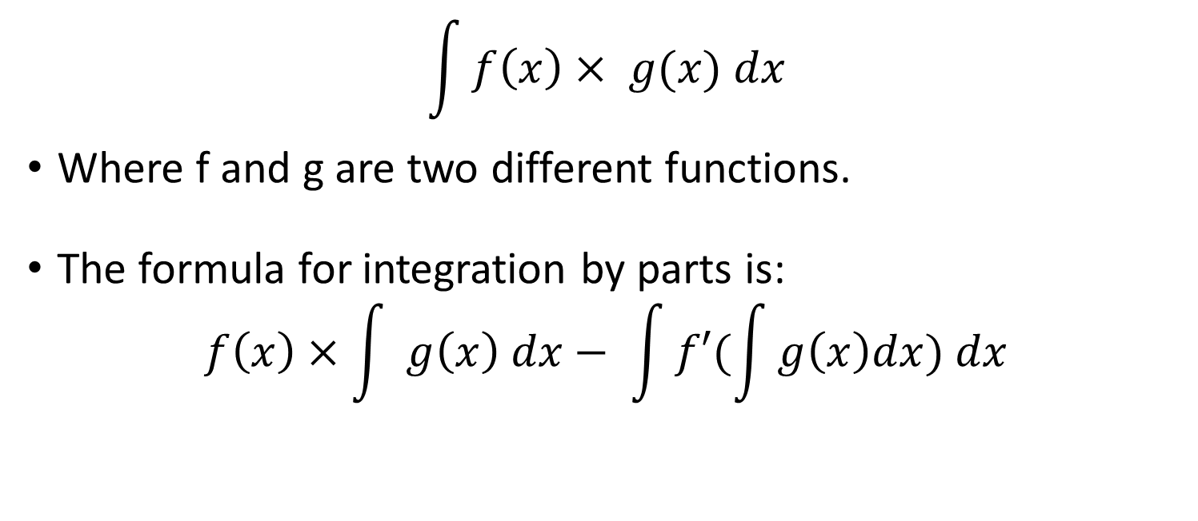
Integration and antiderivatives
$$\int{f\left(x\right)× g(x) dx}$$
Where f and g are two different functions.
The formula for integration by parts is:
$$f\left(x\right)×\int{ g\left(x\right) dx}− \int{f′(\int{g\left(x\right)dx) dx}}$$

Slide 73
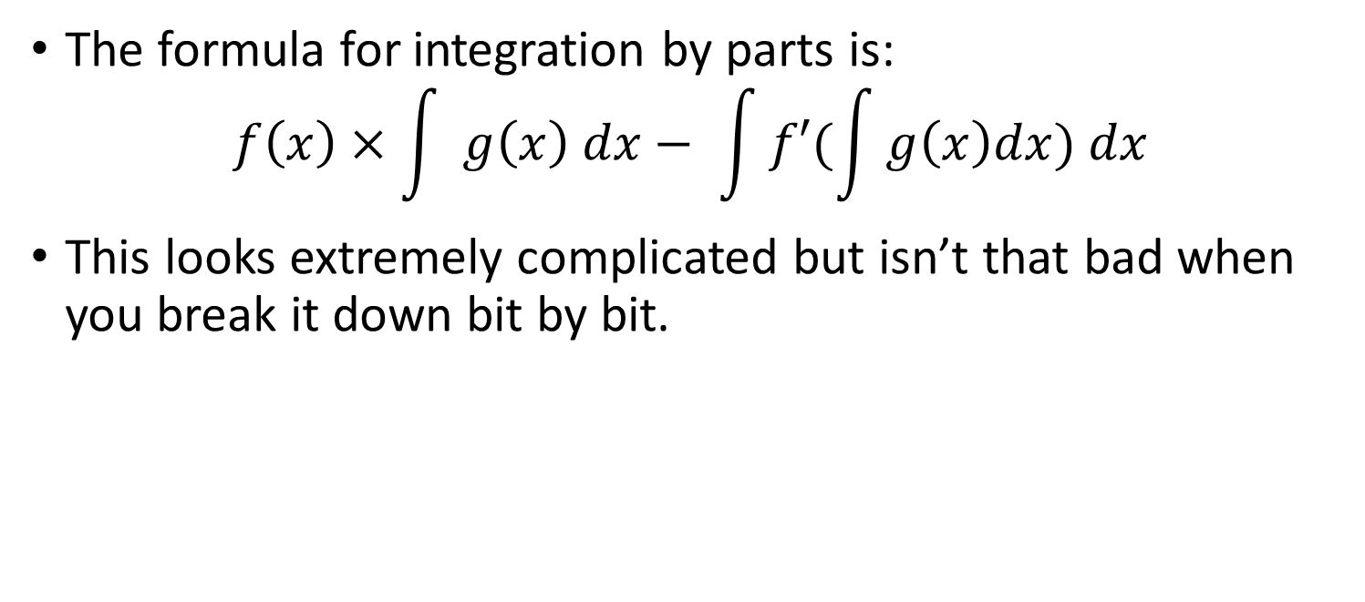
Integration and antiderivatives
The formula for integration by parts is:
$$f\left(x\right)×\int{ g\left(x\right) dx}− \int{f′(\int{g\left(x\right)dx) dx}}$$
This looks extremely complicated but isn’t that bad when you break it down bit by bit.

Slide 74

Integration and antiderivatives
The formula for integration by parts is:
$$f\left(x\right)×\int{ g\left(x\right) dx}− \int{f′×(\int{g\left(x\right)dx) dx}}$$
Function 1
Integral of function 2
Function 1 derivative
Integral of function 2
Integral of the product

Slide 75

Integration and antiderivatives
Integral of the product
Lets try it: xCos(x)
$$f\left(x\right)×\int{ g\left(x\right) dx}− \int{f′×(\int{g\left(x\right)dx) dx}}$$
$$x × \int{Cos\left(x\right)dx} − \int{1 ×(\int{Cos\left(x\right)dx)}dx}$$
Function 1
Integral of function 2
Function 1 derivative
Integral of function 2

Slide 76

Integration and antiderivatives
Integral of the product
Lets try it: xCos(x)
$$f\left(x\right)×\int{ g\left(x\right) dx}− \int{f′×(\int{g\left(x\right)dx) dx}}$$
$$x ×sin⁡(x) − \int{1 ×−sin\left(x\right)dx}$$
Function 1
Integral of function 2
Function 1 derivative
Integral of function 2

Slide 77

Integration and antiderivatives
Integral of the product
Lets try it: xCos(x)
$$f\left(x\right)×\int{ g\left(x\right) dx}− \int{f′×(\int{g\left(x\right)dx) dx}}$$
$$x\sin\left(x\right)+\cos\left(x\right)+C$$
Function 1
Integral of function 2
Function 1 derivative
Integral of function 2

